Slide 1


Embedded Systems Design
Chapter 8: Program Flow Instructions
8.1 Unconditional Jumps & Branches - Overview
Brock J. LaMeres, Ph.D.

Slide 2
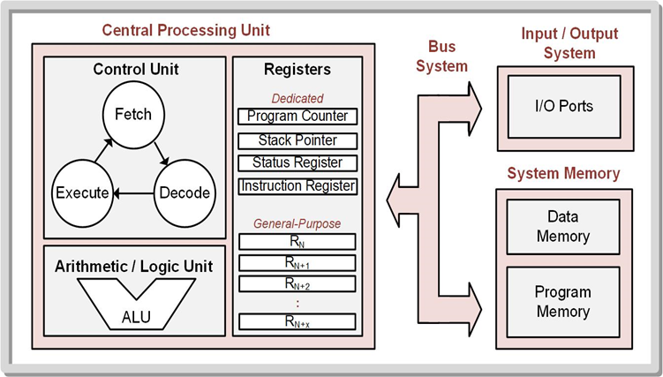
Ch. 8: Program Flow Instructions
8.1 Jumps & Branches
Program Counter (PC) – holds address of the next instruction to fetch while executing the current instruction.
8.1 Unconditional Jumps & Branches

Slide 3
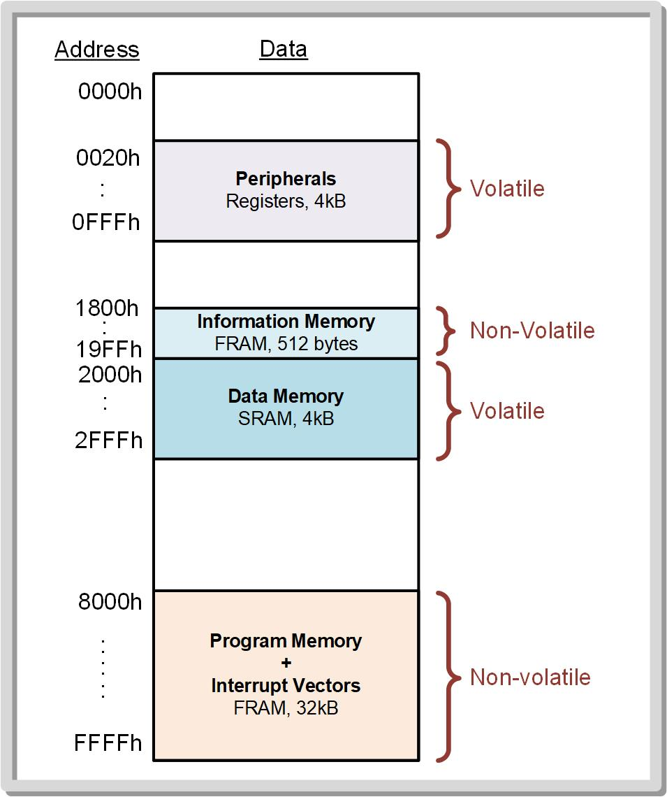
Ch. 8: Program Flow Instructions
8.1 Jumps & Branches
Program Counter (PC)
PC
8.1 Unconditional Jumps & Branches

Slide 4
Ch. 8: Program Flow Instructions
8.1 Jumps & Branches
Program Counter (PC)
PC
8.1 Unconditional Jumps & Branches

Slide 5
Ch. 8: Program Flow Instructions
8.1 Jumps & Branches
Program Counter (PC)
PC
Loop
while(), for()
8.1 Unconditional Jumps & Branches

Slide 6
Ch. 8: Program Flow Instructions
8.1 Jumps & Branches
Program Counter (PC)
PC
8.1 Unconditional Jumps & Branches

Slide 7
Ch. 8: Program Flow Instructions
8.1 Jumps & Branches
Program Counter (PC)
PC
Selective Execution
If/else, case
8.1 Unconditional Jumps & Branches

Slide 8
Ch. 8: Program Flow Instructions
8.1 Jumps & Branches
Jump/Branch – instructions that set the PC to a different value other than the next subsequent instruction in memory.
This allows blocks of instructions to be repeated (a loop) or blocks of code to be selectively executed (if/else).
8.1 Unconditional Jumps & Branches

Slide 9

Ch. 8: Program Flow Instructions
8.1 Jumps & Branches
Unconditional instructions – alter the PC when they are executed.
Image Courtesy of https://neodem.wp.horizon.ac.uk/
Image Courtesy of https://neodem.wp.horizon.ac.uk/
8.1 Unconditional Jumps & Branches

Slide 10
Ch. 8: Program Flow Instructions
8.1 Jumps & Branches
Unconditional instructions – alter the PC when they are executed.
Conditional instructions – only alter the PC when certain conditions exist on the VNZC flags in the SR.
Image Courtesy of https://neodem.wp.horizon.ac.uk/
Image Courtesy of https://neodem.wp.horizon.ac.uk/
8.1 Unconditional Jumps & Branches

Slide 11
Ch. 8: Program Flow Instructions
8.1 Jumps & Branches
Unconditional instructions – alter the PC when they are executed.
Conditional instructions – only alter the PC when certain conditions exist on the VNZC flags in the SR.
Address labels are essential to program flow instructions.
Image Courtesy of https://neodem.wp.horizon.ac.uk/
Image Courtesy of https://neodem.wp.horizon.ac.uk/
8.1 Unconditional Jumps & Branches

Slide 12
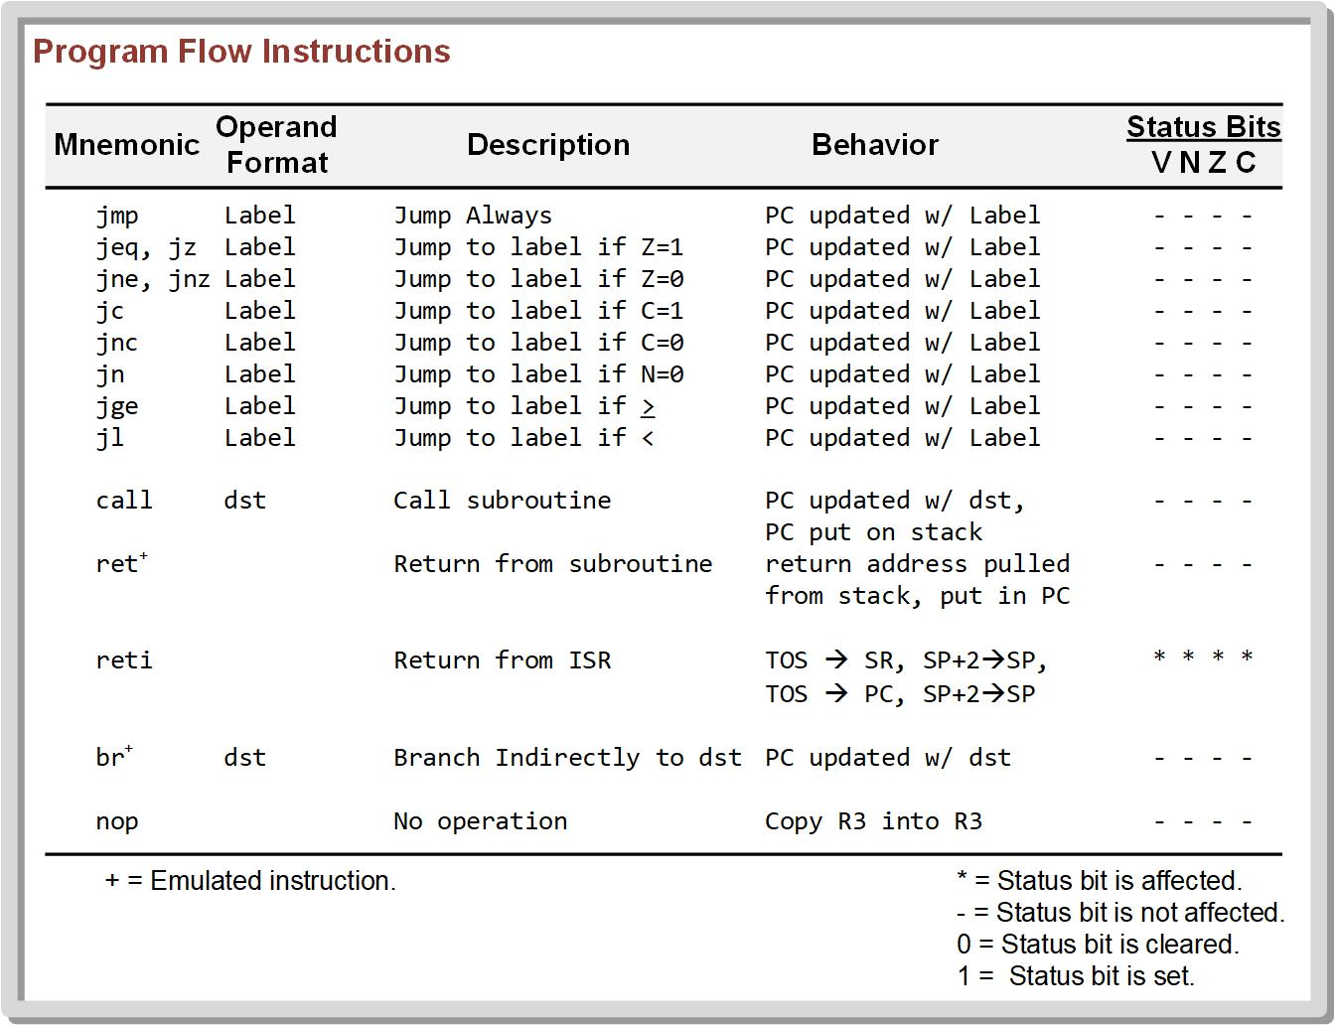
Ch. 8: Program Flow Instructions
8.1 Jumps & Branches
Unconditional
8.1 Unconditional Jumps & Branches

Slide 13
Ch. 8: Program Flow Instructions
8.1 Jumps & Branches
Conditional
(VNZC)
8.1 Unconditional Jumps & Branches

Slide 14
Ch. 8: Program Flow Instructions
8.1 Jumps & Branches
Branch – an unconditional program flow instruction that simply moves the value of the src operand into PC.
One instruction (br)
Almost always uses immediate mode addressing to specify the address of the label.
The branch instruction takes three words of program memory.
Image Courtesy of https://neodem.wp.horizon.ac.uk/
Image Courtesy of https://neodem.wp.horizon.ac.uk/
8.1 Unconditional Jumps & Branches

Slide 15
Ch. 8: Program Flow Instructions
8.1 Jumps & Branches
Jump - program flow instruction that either unconditionally or conditionall alters the PC, but does not use the src operand as an address directly.
The jmp instruction executes faster because it only takes one word of program memory compared to the three words that br takes.
If the jump offset calculated during assembly happens to be outside of the -511 to +512 range, the assembler will give a “jump out of range” error. A branch will fix this error.
A jump almost always uses symbolic mode addressing with an addressing with an address label of where to jump.
Image Courtesy of https://neodem.wp.horizon.ac.uk/
Image Courtesy of https://neodem.wp.horizon.ac.uk/
8.1 Unconditional Jumps & Branches

Slide 16

Embedded Systems Design
Chapter 8: Program Flow Instructions
8.1 Unconditional Jumps & Branches - Overview
www.youtube.com/c/DigitalLogicProgramming_LaMeres
Brock J. LaMeres, Ph.D.

Slide 17
Embedded Systems Design
Chapter 8: Program Flow Instructions
8.1 Unconditional Jumps & Branches - Example
Brock J. LaMeres, Ph.D.

Slide 18
Ch. 8: Program Flow Instructions
8.1 Unconditional Branch
Branch – an unconditional program flow instruction that simply moves the value of the src operand into PC.
One instruction (br)
Almost always uses immediate mode addressing to specify the address of the label.
The branch instruction takes three words of program memory.
Image Courtesy of https://neodem.wp.horizon.ac.uk/
Image Courtesy of https://neodem.wp.horizon.ac.uk/
8.1 Unconditional Jumps & Branches

Slide 19
Ch. 8: Program Flow Instructions
8.1 Unconditional Jump
Jump - program flow instruction that always alters the PC, but does not use the src operand as an address directly.
The jmp instruction executes faster because it only takes one word of program memory compared to the three words that br takes.
If the jump offset calculated during assembly happens to be outside of the -511 to +512 range, the assembler will give a “jump out of range” error. A branch will fix this error.
A jump almost always uses symbolic mode addressing with an addressing with an address label of where to jump.
Image Courtesy of https://neodem.wp.horizon.ac.uk/
Image Courtesy of https://neodem.wp.horizon.ac.uk/
8.1 Unconditional Jumps & Branches

Slide 20
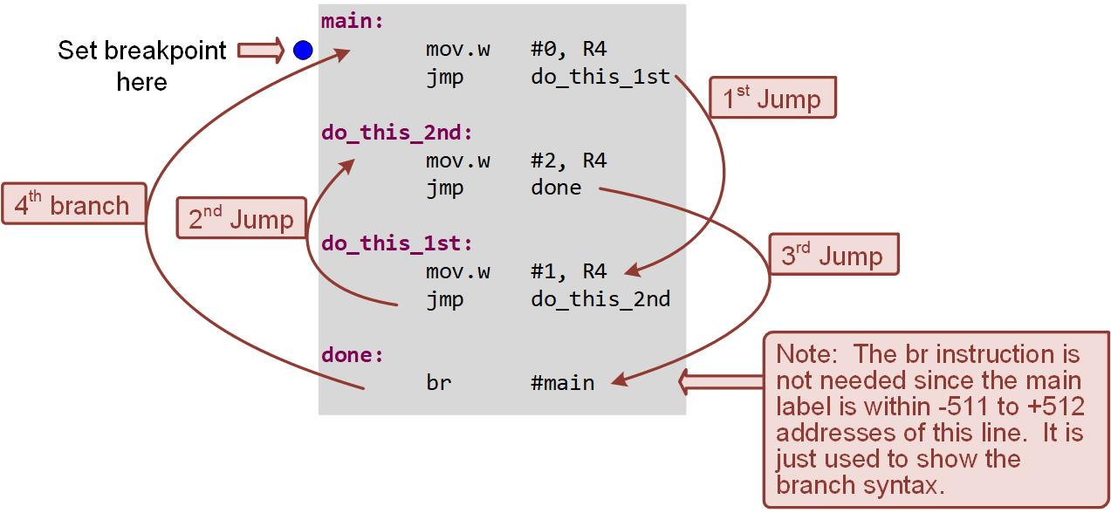
Ch. 8: Program Flow Instructions
Example: Using Unconditional Jumps & Branches
8.1 Unconditional Jumps & Branches

Slide 21
Ch. 8: Program Flow Instructions
Example: Using Unconditional Jumps & Branches
Step 1: Create a new Empty Assembly-only project titled:
Asm_Flow_Jump_n_Branch
Step 2: Type in the following code into the main.asm file where the comments say “Main loop here.”
Image Courtesy of https://neodem.wp.horizon.ac.uk/
Image Courtesy of https://neodem.wp.horizon.ac.uk/
8.1 Unconditional Jumps & Branches

Slide 22

Ch. 8: Program Flow Instructions
Example: Using Unconditional Jumps & Branches
Step 3: Debug your program and correct any errors.
Step 4: Set a breakpoint before the first instruction
mov.w #0, R4
Step 5: Open the register viewer and expand the Core Registers item to see the Program Counter.
Step 6: Run your program to the breakpoint.
Step 7: Step your program to observe its operations.
Image Courtesy of
Recording Connection of Canada
Image Courtesy of
Recording Connection of Canada
Image Courtesy of
Recording Connection of Canada
Image Courtesy of
Recording Connection of Canada
Image Courtesy of
Recording Connection of Canada
Image Courtesy of
Recording Connection of Canada
Image Courtesy of
Recording Connection of Canada
Image Courtesy of
Recording Connection of Canada
Image Courtesy of
Recording Connection of Canada
Image Courtesy of
Recording Connection of Canada
Image Courtesy of https://neodem.wp.horizon.ac.uk/
8.1 Unconditional Jumps & Branches

Slide 23

Ch. 8: Program Flow Instructions
Example: Using Unconditional Jumps & Branches
Step 6: Run your program to the breakpoint.
Step 7: Step your program to observe its operation.
Image Courtesy of
Recording Connection of Canada
Image Courtesy of
Recording Connection of Canada
Image Courtesy of
Recording Connection of Canada
Image Courtesy of
Recording Connection of Canada
Image Courtesy of
Recording Connection of Canada
Image Courtesy of
Recording Connection of Canada
Image Courtesy of
Recording Connection of Canada
Image Courtesy of
Recording Connection of Canada
Image Courtesy of
Recording Connection of Canada
Image Courtesy of
Recording Connection of Canada
Image Courtesy of https://neodem.wp.horizon.ac.uk/
Image Courtesy of https://neodem.wp.horizon.ac.uk/
8.1 Unconditional Jumps & Branches

Slide 24
Embedded Systems Design
Chapter 8: Program Flow Instructions
8.1 Unconditional Jumps & Branches - Example
www.youtube.com/c/DigitalLogicProgramming_LaMeres
Brock J. LaMeres, Ph.D.

Slide 25
Embedded Systems Design
Chapter 8: Program Flow Instructions
8.2 Conditional Jumps – Carry-Based Jumps
Brock J. LaMeres, Ph.D.

Slide 26
Ch. 8: Program Flow Instructions
8.2 Conditional Jumps
Conditional jumps – alter the program counter when certain conditions exist in the status flags within the status register.
Conditional jump instruction – alter the program counter if the condition is true.
If the condition is true, the program counter jumps to a new location in the program.
If the condition is false, the program counter will simply move onto the next instruction residing in memory.
Image Courtesy of
Recording Connection of Canada
Image Courtesy of
Recording Connection of Canada
Image Courtesy of
Recording Connection of Canada
Image Courtesy of
Recording Connection of Canada
Image Courtesy of
Recording Connection of Canada
Image Courtesy of
Recording Connection of Canada
Image Courtesy of
Recording Connection of Canada
Image Courtesy of
Recording Connection of Canada
Image Courtesy of
Recording Connection of Canada
Image Courtesy of
Recording Connection of Canada
Image Courtesy of
Recording Connection of Canada
Image Courtesy of https://neodem.wp.horizon.ac.uk/
Image Courtesy of https://neodem.wp.horizon.ac.uk/
8.2 Conditional Jumps

Slide 27
Ch. 8: Program Flow Instructions
8.2.1 Carry-Based Jumps
Jump if carry (jc) – alter the program counter if C = 1, otherwise it will simply move on to the next instruction in memory.
Jump if no carry (jnc) – alter the program counter if C = 0, otherwise it will simply move on to the next instruction in memory.
8.2 Conditional Jumps

Slide 28
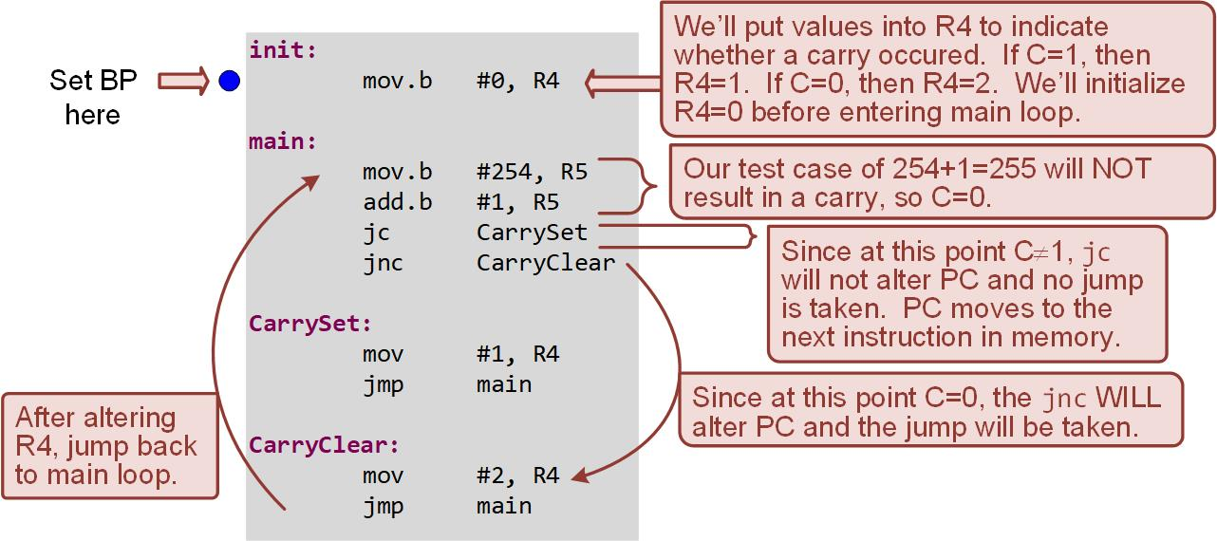
Ch. 8: Program Flow Instructions
Example: Using Jumps Based on the Carry Flag (JC, JNC)
8.2 Conditional Jumps

Slide 29
Ch. 8: Program Flow Instructions
Example: Using Jumps Based on the Carry Flag (JC, JNC)
Step 1: Create a new Empty Assembly-only project titled:
Asm_Flow_Carry_Jumps
Step 2: Type in the following code into the main.asm file where the comments say “Main loop here.”
Image Courtesy of
Recording Connection of Canada
Image Courtesy of
Recording Connection of Canada
Image Courtesy of
Recording Connection of Canada
Image Courtesy of
Recording Connection of Canada
Image Courtesy of
Recording Connection of Canada
Image Courtesy of
Recording Connection of Canada
Image Courtesy of
Recording Connection of Canada
Image Courtesy of
Recording Connection of Canada
Image Courtesy of
Recording Connection of Canada
Image Courtesy of
Recording Connection of Canada
Image Courtesy of https://neodem.wp.horizon.ac.uk/
Image Courtesy of https://neodem.wp.horizon.ac.uk/
8.2 Conditional Jumps

Slide 30
Ch. 8: Program Flow Instructions
Example: Using Jumps Based on the Carry Flag (JC, JNC)
Step 3: Debug your program and correct any errors.
Step 4: Set a breakpoint before the first instruction
mov.b #0, R4
Step 5: Open the register viewer and expand the Core Registers and the Status Register so you can see the Carry flag, PC, R4, and R5. Change the format of R4 and R5 to decimal.
Image Courtesy of
Recording Connection of Canada
Image Courtesy of
Recording Connection of Canada
Image Courtesy of
Recording Connection of Canada
Image Courtesy of
Recording Connection of Canada
Image Courtesy of
Recording Connection of Canada
Image Courtesy of
Recording Connection of Canada
Image Courtesy of
Recording Connection of Canada
Image Courtesy of
Recording Connection of Canada
Image Courtesy of
Recording Connection of Canada
Image Courtesy of
Recording Connection of Canada
Image Courtesy of
Recording Connection of Canada
Image Courtesy of
Recording Connection of Canada
Image Courtesy of
Recording Connection of Canada
Image Courtesy of
Recording Connection of Canada
Image Courtesy of
Recording Connection of Canada
Image Courtesy of
Recording Connection of Canada
Image Courtesy of
Recording Connection of Canada
Image Courtesy of
Recording Connection of Canada
Image Courtesy of
Recording Connection of Canada
Image Courtesy of
Recording Connection of Canada
Image Courtesy of https://neodem.wp.horizon.ac.uk/
Image Courtesy of https://neodem.wp.horizon.ac.uk/
8.2 Conditional Jumps

Slide 31
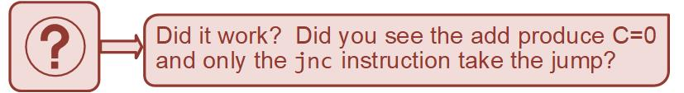
Ch. 8: Program Flow Instructions
Example: Using Jumps Based on the Carry Flag (JC, JNC)
Step 6: Run your program to the breakpoint.
Step 7: Step your program to observe its operation.
Step 8: Now change the src of the second mov instruction from 254 to 255 (mov.b #255, R5).
Step 9: Debug the program and observe the behavior of the program.
Image Courtesy of
Recording Connection of Canada
Image Courtesy of
Recording Connection of Canada
Image Courtesy of
Recording Connection of Canada
Image Courtesy of
Recording Connection of Canada
Image Courtesy of
Recording Connection of Canada
Image Courtesy of
Recording Connection of Canada
Image Courtesy of
Recording Connection of Canada
Image Courtesy of
Recording Connection of Canada
Image Courtesy of
Recording Connection of Canada
Image Courtesy of
Recording Connection of Canada
Image Courtesy of https://neodem.wp.horizon.ac.uk/
Image Courtesy of https://neodem.wp.horizon.ac.uk/
8.2 Conditional Jumps

Slide 32
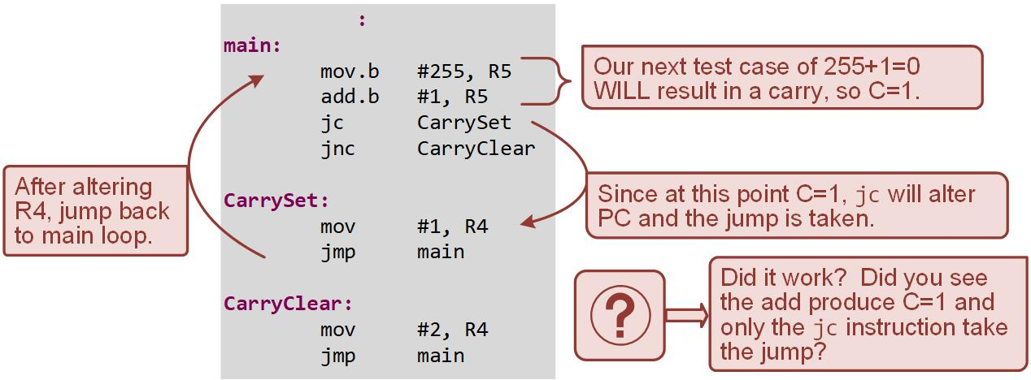
Ch. 8: Program Flow Instructions
Example: Using Jumps Based on the Carry Flag (JC, JNC)
8.2 Conditional Jumps

Slide 33
Embedded Systems Design
Chapter 8: Program Flow Instructions
8.2 Conditional Jumps – Carry-Based Jumps
www.youtube.com/c/DigitalLogicProgramming_LaMeres
Brock J. LaMeres, Ph.D.

Slide 34
Embedded Systems Design
Chapter 8: Program Flow Instructions
8.2 Conditional Jumps – Zero-Based Jumps
Brock J. LaMeres, Ph.D.

Slide 35
Ch. 8: Program Flow Instructions
8.2.2 Zero-Based Jumps
Jump if zero (jz) – alter the program counter if Z = 1, otherwise it will simply move on to the next instruction in memory.
Jump if no zero (jnz) – alter the program counter if Z = 0, otherwise it will simply move on to the next instruction in memory.
8.2 Conditional Jumps

Slide 36
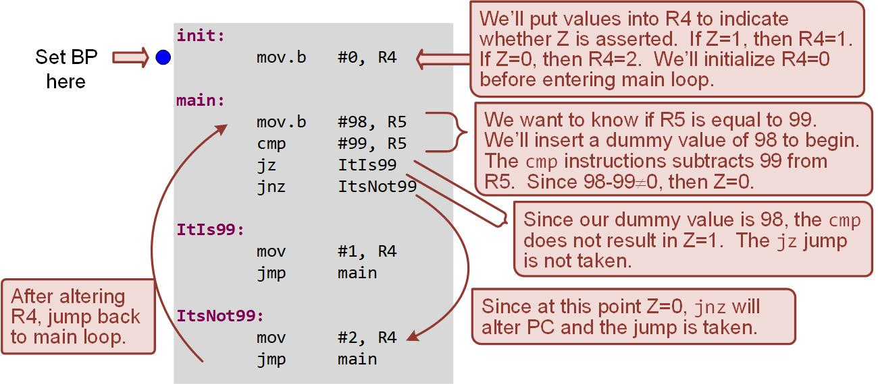
Ch. 8: Program Flow Instructions
Example: Using Jumps Based on the Zero Flag (JZ, JNZ)
8.2 Conditional Jumps

Slide 37
Ch. 8: Program Flow Instructions
Example: Using Jumps Based on the Zero Flag (JZ, JNZ)
Step 1: Create a new Empty Assembly-only project titled:
Asm_Flow_Zero_Jumps
Step 2: Type in the following code into the main.asm file where the comments say “Main loop here.”
Image Courtesy of
Recording Connection of Canada
Image Courtesy of
Recording Connection of Canada
Image Courtesy of
Recording Connection of Canada
Image Courtesy of
Recording Connection of Canada
Image Courtesy of
Recording Connection of Canada
Image Courtesy of
Recording Connection of Canada
Image Courtesy of
Recording Connection of Canada
Image Courtesy of
Recording Connection of Canada
Image Courtesy of
Recording Connection of Canada
Image Courtesy of
Recording Connection of Canada
Image Courtesy of https://neodem.wp.horizon.ac.uk/
Image Courtesy of https://neodem.wp.horizon.ac.uk/
8.2 Conditional Jumps

Slide 38
Ch. 8: Program Flow Instructions
Example: Using Jumps Based on the Zero Flag (JZ, JNZ)
Step 3: Debug your program and correct any errors.
Step 4: Set a breakpoint before the first instruction
mov.b #0, R4
Step 5: Open the register viewer and expand the Core Registers and the Status Register so you can see the Zero flag, PC, R4, and R5. Change the format of R4 and R5 to decimal.
Image Courtesy of
Recording Connection of Canada
Image Courtesy of
Recording Connection of Canada
Image Courtesy of
Recording Connection of Canada
Image Courtesy of
Recording Connection of Canada
Image Courtesy of
Recording Connection of Canada
Image Courtesy of
Recording Connection of Canada
Image Courtesy of
Recording Connection of Canada
Image Courtesy of
Recording Connection of Canada
Image Courtesy of
Recording Connection of Canada
Image Courtesy of
Recording Connection of Canada
Image Courtesy of
Recording Connection of Canada
Image Courtesy of
Recording Connection of Canada
Image Courtesy of
Recording Connection of Canada
Image Courtesy of
Recording Connection of Canada
Image Courtesy of
Recording Connection of Canada
Image Courtesy of
Recording Connection of Canada
Image Courtesy of
Recording Connection of Canada
Image Courtesy of
Recording Connection of Canada
Image Courtesy of
Recording Connection of Canada
Image Courtesy of
Recording Connection of Canada
Image Courtesy of https://neodem.wp.horizon.ac.uk/
Image Courtesy of https://neodem.wp.horizon.ac.uk/
8.2 Conditional Jumps

Slide 39

Ch. 8: Program Flow Instructions
Example: Using Jumps Based on the Zero Flag (JZ, JNZ)
Step 6: Run your program to the breakpoint.
Step 7: Step your program to observe its operation.
Step 8: Now change the src of the second mov instruction from 98 to 99 (mov.b #99, R5).
Step 9: Debug the program and observe the behavior of the program.
Image Courtesy of
Recording Connection of Canada
Image Courtesy of
Recording Connection of Canada
Image Courtesy of
Recording Connection of Canada
Image Courtesy of
Recording Connection of Canada
Image Courtesy of
Recording Connection of Canada
Image Courtesy of
Recording Connection of Canada
Image Courtesy of
Recording Connection of Canada
Image Courtesy of
Recording Connection of Canada
Image Courtesy of
Recording Connection of Canada
Image Courtesy of
Recording Connection of Canada
Image Courtesy of https://neodem.wp.horizon.ac.uk/
Image Courtesy of https://neodem.wp.horizon.ac.uk/
8.2 Conditional Jumps

Slide 40
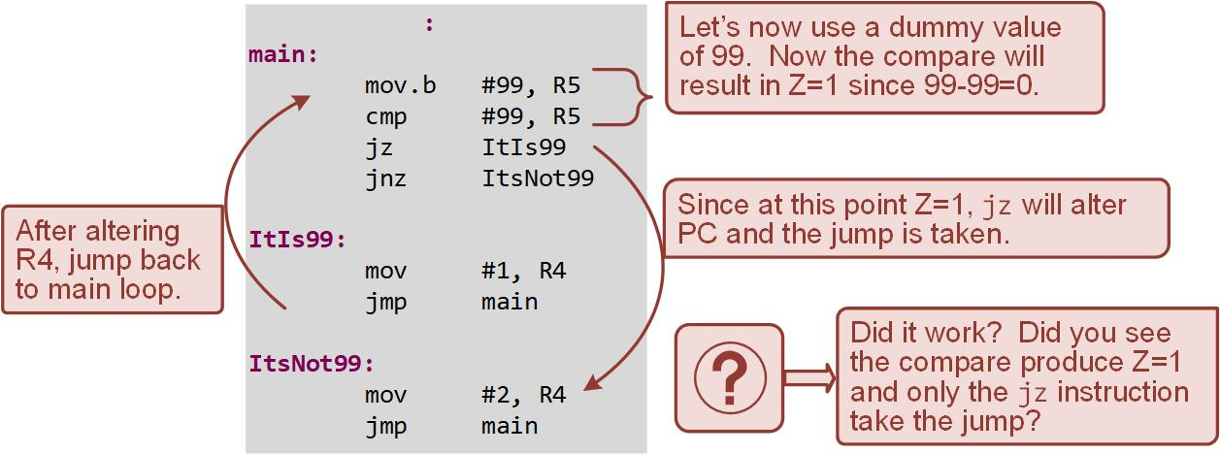
Ch. 8: Program Flow Instructions
Example: Using Jumps Based on the Zero Flag (JZ, JNZ)
8.2 Conditional Jumps

Slide 41
Embedded Systems Design
Chapter 8: Program Flow Instructions
8.2 Conditional Jumps – Zero-Based Jumps
www.youtube.com/c/DigitalLogicProgramming_LaMeres
Brock J. LaMeres, Ph.D.

Slide 42
Embedded Systems Design
Chapter 8: Program Flow Instructions
8.2 Conditional Jumps – Negative-Based Jumps
Brock J. LaMeres, Ph.D.

Slide 43
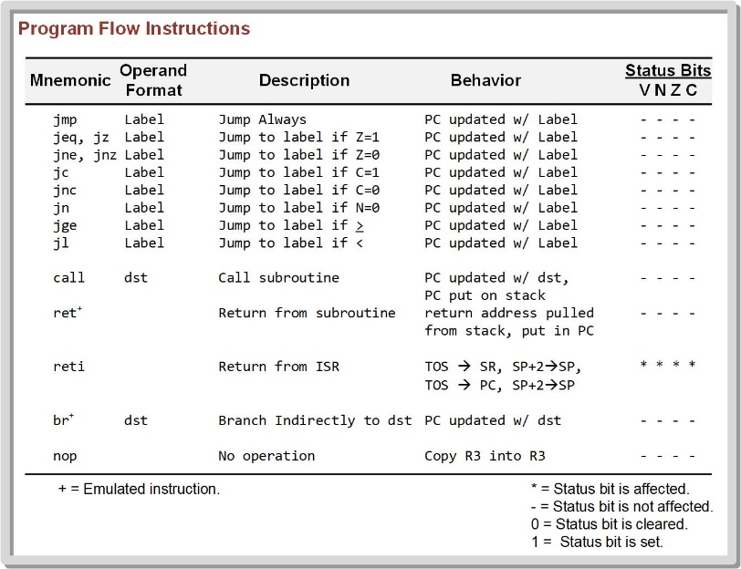
Ch. 8: Program Flow Instructions
8.2.3 Negative-Based Jumps
Jump if negative (jn) – alter the program counter if N = 1, otherwise it will simply move on to the next instruction in memory.
There is no jump if not negative instruction in the MSP430 instruction set; however, this condition can be created using the logic that if the result is not negative, it must be positive.
8.2 Conditional Jumps

Slide 44
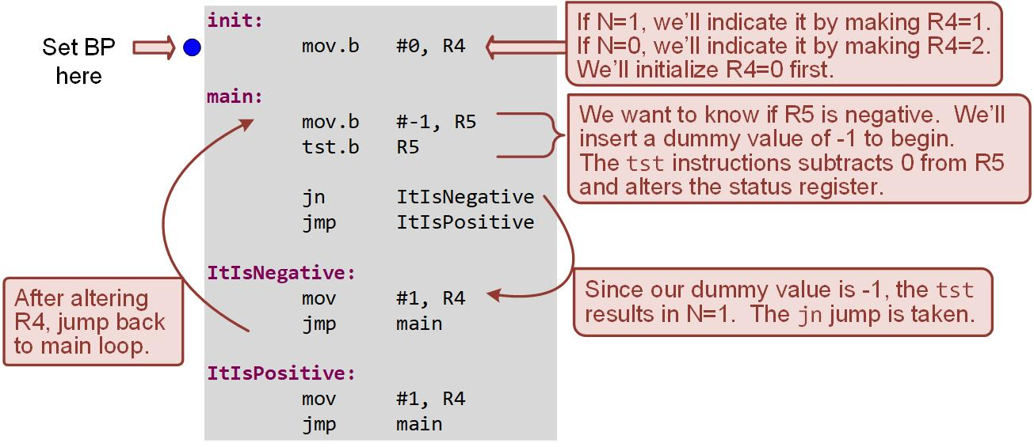
Ch. 8: Program Flow Instructions
Example: Using Jumps Based on the Negative Flag (JN)
8.2 Conditional Jumps

Slide 45
Ch. 8: Program Flow Instructions
Example: Using Jumps Based on the Negative Flag (JN)
Step 1: Create a new Empty Assembly-only project titled:
Asm_Flow_Negative_Jumps
Step 2: Type in the following code into the main.asm file where the comments say “Main loop here.”
Image Courtesy of https://neodem.wp.horizon.ac.uk/
Image Courtesy of https://neodem.wp.horizon.ac.uk/
8.2 Conditional Jumps

Slide 46
Ch. 8: Program Flow Instructions
Example: Using Jumps Based on the Negative Flag (JN)
Step 3: Debug your program and correct any errors.
Step 4: Set a breakpoint before the first instruction
mov.b #0, R4
Step 5: Open the register viewer and expand the Core Registers and the Status Register so you can see the Negative flag, PC, R4, and R5. Change the format of R4 and R5 to decimal.
Image Courtesy of https://neodem.wp.horizon.ac.uk/
Image Courtesy of https://neodem.wp.horizon.ac.uk/
8.2 Conditional Jumps

Slide 47

Ch. 8: Program Flow Instructions
Example: Using Jumps Based on the Negative Flag (JN)
Step 6: Run your program to the breakpoint.
Step 7: Step your program to observe its operation.
Step 8: Now change the src of the second mov instruction from -1 to 1 (mov.b #1, R5).
Step 9: Debug the program and observe the behavior of the program.
Image Courtesy of https://neodem.wp.horizon.ac.uk/
Image Courtesy of https://neodem.wp.horizon.ac.uk/
8.2 Conditional Jumps

Slide 48
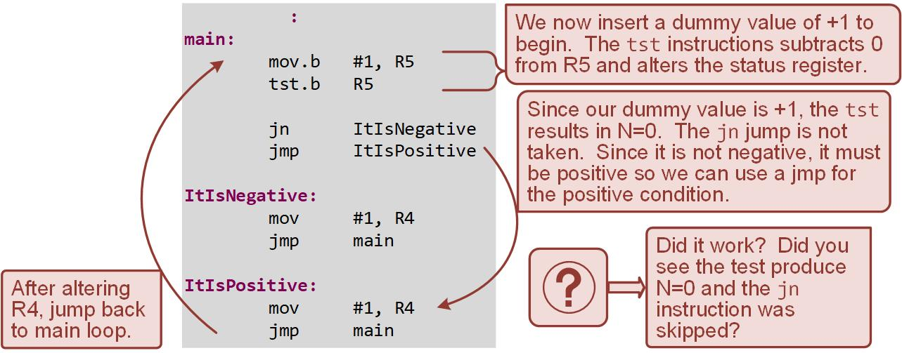
Ch. 8: Program Flow Instructions
Example: Using Jumps Based on the Negative Flag (JN)
8.2 Conditional Jumps

Slide 49
Embedded Systems Design
Chapter 8: Program Flow Instructions
8.2 Conditional Jumps – Negative-Based Jumps
www.youtube.com/c/DigitalLogicProgramming_LaMeres
Brock J. LaMeres, Ph.D.

Slide 50
Embedded Systems Design
Chapter 8: Program Flow Instructions
8.2 Conditional Jumps – Overflow-Based Jumps
Brock J. LaMeres, Ph.D.

Slide 51
Ch. 8: Program Flow Instructions
8.2.4 Overflow-Based Jumps
8.2 Conditional Jumps

Slide 52
Ch. 8: Program Flow Instructions
8.2.4 Overflow-Based Jumps
Jump if greater than or equal (jge) – provide the ability to jump based on inequalities and also to consider two’s compliment overflow. Jumps when
N xor V = 0
These jumps use both the N-flag and V-flag and assume the results are signed numbers.
jump if less than (jl) - provide the ability to jump based on inequalities and also to consider two’s compliment overflow. Jumps when
N xor V = 1
Both instructions are easier to understand by simply using their mnemonic description ( > and < ).
Image Courtesy of https://neodem.wp.horizon.ac.uk/
Image Courtesy of https://neodem.wp.horizon.ac.uk/
8.2 Conditional Jumps

Slide 53
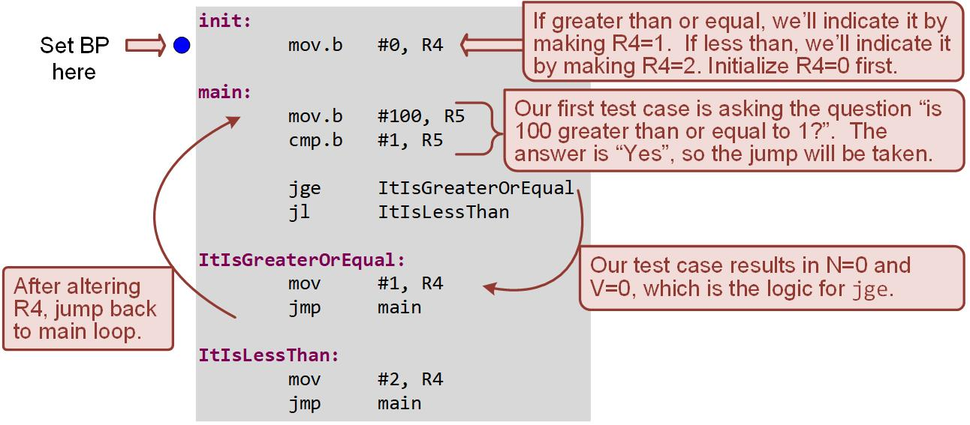
Ch. 8: Program Flow Instructions
Example: Using Jumps Based on Inequalities (JGE, JL)
8.2 Conditional Jumps

Slide 54
Ch. 8: Program Flow Instructions
Example: Using Jumps Based on Inequalities (JGE, JL)
Step 1: Create a new Empty Assembly-only project titled:
Asm_Flow_Inequality_Jumps
Step 2: Type in the following code into the main.asm file where the comments say “Main loop here.”
Image Courtesy of https://neodem.wp.horizon.ac.uk/
Image Courtesy of https://neodem.wp.horizon.ac.uk/
8.2 Conditional Jumps

Slide 55
Ch. 8: Program Flow Instructions
Example: Using Jumps Based on Inequalities (JGE, JL)
Step 3: Debug your program and correct any errors.
Step 4: Set a breakpoint before the first instruction
mov.b #0, R4
Step 5: Open the register viewer and expand the Core Registers and the Status Register so you can see the N and V flags, PC, R4, and R5. Change the format of R4 and R5 to decimal.
Image Courtesy of https://neodem.wp.horizon.ac.uk/
Image Courtesy of https://neodem.wp.horizon.ac.uk/
8.2 Conditional Jumps

Slide 56
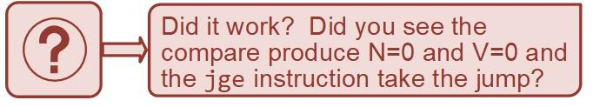
Ch. 8: Program Flow Instructions
Example: Using Jumps Based on Inequalities (JGE, JL)
Step 6: Run your program to the breakpoint.
Step 7: Step your program to observe its operation.
Step 8: Now change the src values of the test case to the code shown: (mov.b #101, R5, cmp #99, R5).
Step 9: Debug the program and observe the behavior of the program.
Image Courtesy of https://neodem.wp.horizon.ac.uk/
Image Courtesy of https://neodem.wp.horizon.ac.uk/
8.2 Conditional Jumps

Slide 57
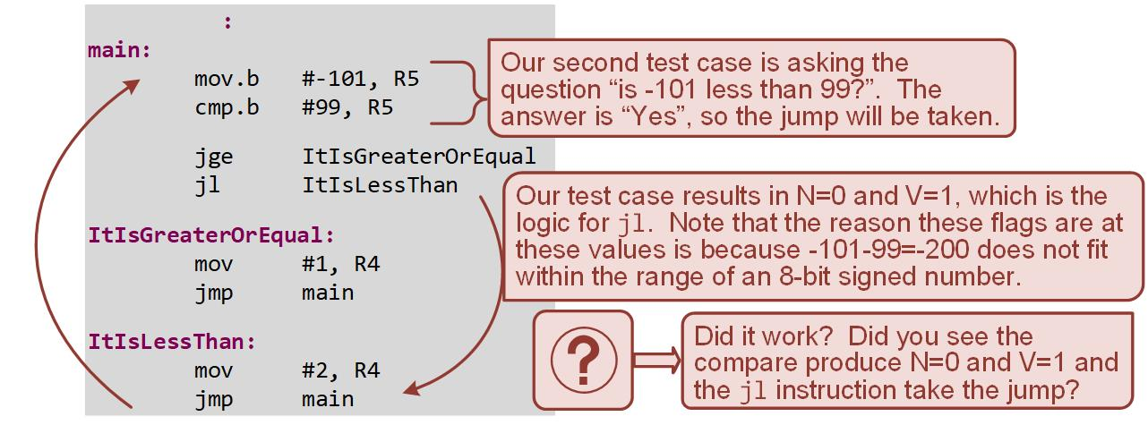
Ch. 8: Program Flow Instructions
Example: Using Jumps Based on Inequalities (JGE, JL)
8.2 Conditional Jumps

Slide 58
Embedded Systems Design
Chapter 8: Program Flow Instructions
8.2 Conditional Jumps – Overflow-Based Jumps
www.youtube.com/c/DigitalLogicProgramming_LaMeres
Brock J. LaMeres, Ph.D.

Slide 59
Embedded Systems Design
Chapter 8: Program Flow Instructions
8.3 Implementing Common Programming Constructs in Assembly - While() Loops
Brock J. LaMeres, Ph.D.

Slide 60
Ch. 8: Program Flow Instructions
8.3.1 Implementing While() Loop Functionality
While() Loop – sequence of statements that will continually execute as long as a Boolean condition at the beginning of the loop is satisfied.
In assembly, this behavior is implemented with a combination of test and compare, and conditional jump instructions.
In the C programming, the Boolean condition is inserted within the parenthesis of the while() keyword and the statements to be executed are listed within curly brackets ({}).
Image Courtesy of
Recording Connection of Canada
Image Courtesy of
Recording Connection of Canada
Image Courtesy of
Recording Connection of Canada
Image Courtesy of
Recording Connection of Canada
Image Courtesy of
Recording Connection of Canada
Image Courtesy of
Recording Connection of Canada
Image Courtesy of
Recording Connection of Canada
Image Courtesy of
Recording Connection of Canada
Image Courtesy of
Recording Connection of Canada
Image Courtesy of
Recording Connection of Canada
Image Courtesy of
Recording Connection of Canada
Image Courtesy of https://neodem.wp.horizon.ac.uk/
Image Courtesy of https://neodem.wp.horizon.ac.uk/
8.3 Implementing Common Programming Constructs in Assembly

Slide 61
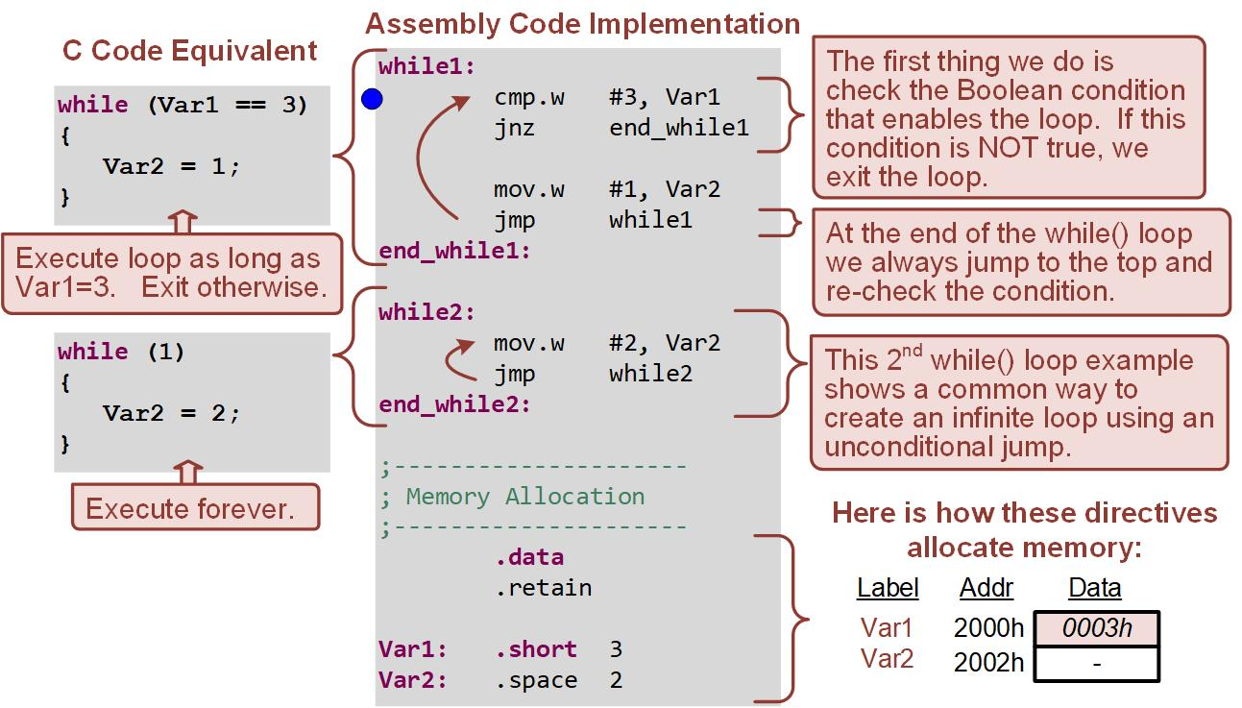
Ch. 8: Program Flow Instructions
Example: Implementing While() Loops in Assembly
8.3 Implementing Common Programming Constructs in Assembly

Slide 62
Ch. 8: Program Flow Instructions
Example: Implementing While() Loops in Assembly
Step 1: Create a new Empty Assembly-only project titled:
Asm_Flow_While_Loops
Step 2: Type in the following code into the main.asm file where the comments say “Main loop here.”
Image Courtesy of
Recording Connection of Canada
Image Courtesy of
Recording Connection of Canada
Image Courtesy of
Recording Connection of Canada
Image Courtesy of
Recording Connection of Canada
Image Courtesy of
Recording Connection of Canada
Image Courtesy of
Recording Connection of Canada
Image Courtesy of
Recording Connection of Canada
Image Courtesy of
Recording Connection of Canada
Image Courtesy of
Recording Connection of Canada
Image Courtesy of
Recording Connection of Canada
Image Courtesy of https://neodem.wp.horizon.ac.uk/
Image Courtesy of https://neodem.wp.horizon.ac.uk/
8.3 Implementing Common Programming Constructs in Assembly

Slide 63
Ch. 8: Program Flow Instructions
Example: Implementing While() Loops in Assembly
Step 3: Debug your program and correct any errors.
Step 4: Set a breakpoint before the first instruction
cmp.w #3, Var1
Step 5: Open the memory browser and go to address 0x2000. You should see a word at 0x2000 initialized to 3 and a word at 0x2002 reserved with no values.
Image Courtesy of
Recording Connection of Canada
Image Courtesy of
Recording Connection of Canada
Image Courtesy of
Recording Connection of Canada
Image Courtesy of
Recording Connection of Canada
Image Courtesy of
Recording Connection of Canada
Image Courtesy of
Recording Connection of Canada
Image Courtesy of
Recording Connection of Canada
Image Courtesy of
Recording Connection of Canada
Image Courtesy of
Recording Connection of Canada
Image Courtesy of
Recording Connection of Canada
Image Courtesy of
Recording Connection of Canada
Image Courtesy of
Recording Connection of Canada
Image Courtesy of
Recording Connection of Canada
Image Courtesy of
Recording Connection of Canada
Image Courtesy of
Recording Connection of Canada
Image Courtesy of
Recording Connection of Canada
Image Courtesy of
Recording Connection of Canada
Image Courtesy of
Recording Connection of Canada
Image Courtesy of
Recording Connection of Canada
Image Courtesy of
Recording Connection of Canada
Image Courtesy of https://neodem.wp.horizon.ac.uk/
Image Courtesy of https://neodem.wp.horizon.ac.uk/
8.3 Implementing Common Programming Constructs in Assembly

Slide 64
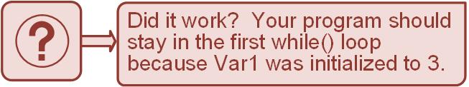
Ch. 8: Program Flow Instructions
Example: Implementing While() Loops in Assembly
Step 6: Run your program to the breakpoint.
Step 7: Step your program to observe the first while() loop’s behavior.
Image Courtesy of
Recording Connection of Canada
Image Courtesy of
Recording Connection of Canada
Image Courtesy of
Recording Connection of Canada
Image Courtesy of
Recording Connection of Canada
Image Courtesy of
Recording Connection of Canada
Image Courtesy of
Recording Connection of Canada
Image Courtesy of
Recording Connection of Canada
Image Courtesy of
Recording Connection of Canada
Image Courtesy of
Recording Connection of Canada
Image Courtesy of
Recording Connection of Canada
Image Courtesy of https://neodem.wp.horizon.ac.uk/
Image Courtesy of https://neodem.wp.horizon.ac.uk/
8.3 Implementing Common Programming Constructs in Assembly

Slide 65
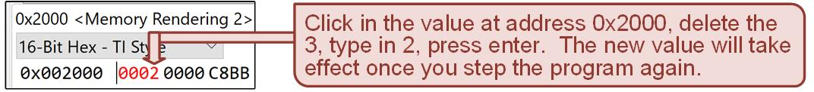

Ch. 8: Program Flow Instructions
Example: Implementing While() Loops in Assembly
Step 8: Now you are going to manually change the value of Var1 from 3 to 2 in the memory browser.
Step 9: Continue stepping your program with the new value of Var1 = 2.
Image Courtesy of
Recording Connection of Canada
Image Courtesy of
Recording Connection of Canada
Image Courtesy of
Recording Connection of Canada
Image Courtesy of
Recording Connection of Canada
Image Courtesy of
Recording Connection of Canada
Image Courtesy of
Recording Connection of Canada
Image Courtesy of
Recording Connection of Canada
Image Courtesy of
Recording Connection of Canada
Image Courtesy of
Recording Connection of Canada
Image Courtesy of
Recording Connection of Canada
Image Courtesy of https://neodem.wp.horizon.ac.uk/
Image Courtesy of https://neodem.wp.horizon.ac.uk/
8.3 Implementing Common Programming Constructs in Assembly

Slide 66
Embedded Systems Design
Chapter 8: Program Flow Instructions
8.3 Implementing Common Programming Constructs in Assembly - While() Loops
www.youtube.com/c/DigitalLogicProgramming_LaMeres
Brock J. LaMeres, Ph.D.

Slide 67
Embedded Systems Design
Chapter 8: Program Flow Instructions
8.3 Implementing Common Programming Constructs in Assembly - For() Loops
Brock J. LaMeres, Ph.D.

Slide 68
Ch. 8: Program Flow Instructions
8.3.2 Implementing For() Loop Functionality
For() Loop – a sequence of statements that will execute a fixed number of times.
The number of times to iterate is specified by stating a loop variable, the starting value of the variable, the final value of the variable, and the method that the variable will be incremented/decremented.
The loop variable can be used as an offset when accessing blocks of storage.
In assembly, for() loop functionality is accomplished using increments/decrements, test, compare, and conditional jump instructions.
Image Courtesy of https://neodem.wp.horizon.ac.uk/
Image Courtesy of https://neodem.wp.horizon.ac.uk/
8.3 Implementing Common Programming Constructs in Assembly

Slide 69
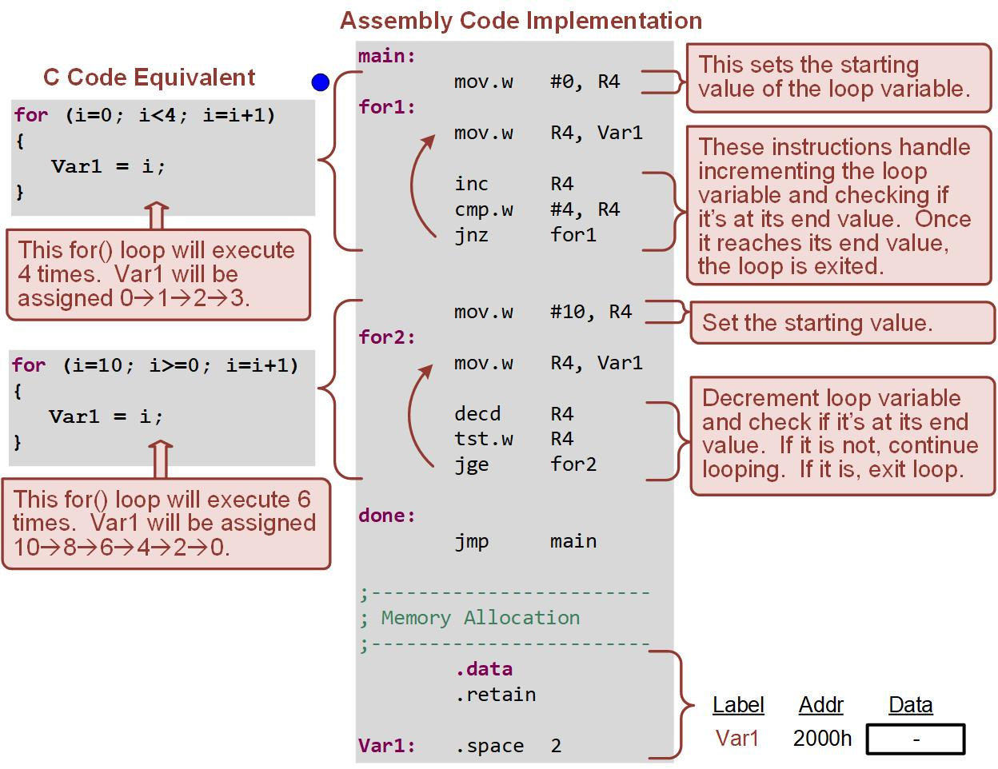
Ch. 8: Program Flow Instructions
Example: Implementing For() Loops in Assembly
i=i-2)
8.3 Implementing Common Programming Constructs in Assembly

Slide 70
Ch. 8: Program Flow Instructions
Example: Implementing For() Loops in Assembly
Step 1: Create a new Empty Assembly-only project titled:
Asm_Flow_For_Loops
Step 2: Type in the following code into the main.asm file where the comments say “Main loop here.”
Image Courtesy of https://neodem.wp.horizon.ac.uk/
Image Courtesy of https://neodem.wp.horizon.ac.uk/
8.3 Implementing Common Programming Constructs in Assembly

Slide 71
Ch. 8: Program Flow Instructions
Example: Implementing For() Loops in Assembly
Step 3: Debug your program and correct any errors.
Step 4: Set a breakpoint before the first instruction
mov.w #0, R4
Step 5: Open the memory browser and go to address 0x2000. You should see a word at 0x2000 reserved with no values.
Image Courtesy of https://neodem.wp.horizon.ac.uk/
Image Courtesy of https://neodem.wp.horizon.ac.uk/
8.3 Implementing Common Programming Constructs in Assembly

Slide 72
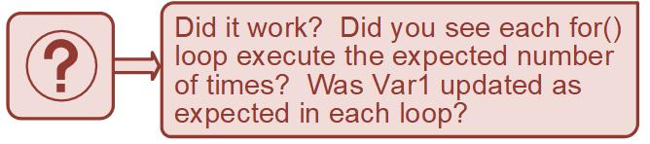
Ch. 8: Program Flow Instructions
Example: Implementing For() Loops in Assembly
Step 6: Run your program to the breakpoint.
Step 7: Step your program to observe the for() loop’s behavior.
Image Courtesy of https://neodem.wp.horizon.ac.uk/
Image Courtesy of https://neodem.wp.horizon.ac.uk/
8.3 Implementing Common Programming Constructs in Assembly

Slide 73
Embedded Systems Design
Chapter 8: Program Flow Instructions
8.3 Implementing Common Programming Constructs in Assembly - For() Loops
www.youtube.com/c/DigitalLogicProgramming_LaMeres
Brock J. LaMeres, Ph.D.

Slide 74
Embedded Systems Design
Chapter 8: Program Flow Instructions
8.3 Implementing Common Programming Constructs in Assembly - if/else Statements
Brock J. LaMeres, Ph.D.

Slide 75
Ch. 8: Program Flow Instructions
8.3.3 Implementing If/Else Functionality
If/else Statement – allows statements to be selectively executed based on the result of a Boolean condition.
A Boolean condition is entered after the if portion of the construct.
If the condition is true, the statements listed within the subsequent curly brackets will be executed.
If the condition is not true, then the first set of statements are skipped, and the statements listed within the curly brackets after the else portion of the construct are executed.
Image Courtesy of https://neodem.wp.horizon.ac.uk/
Image Courtesy of https://neodem.wp.horizon.ac.uk/
8.3 Implementing Common Programming Constructs in Assembly

Slide 76
Ch. 8: Program Flow Instructions
8.3.3 Implementing If/Else Functionality
If/else statements can be nested to provide the ability to check multiple Boolean conditions.
In assembly, if/else functionality is accomplished using compare, unconditional jump, and conditional jump instructions.
Image Courtesy of https://neodem.wp.horizon.ac.uk/
Image Courtesy of https://neodem.wp.horizon.ac.uk/
8.3 Implementing Common Programming Constructs in Assembly

Slide 77
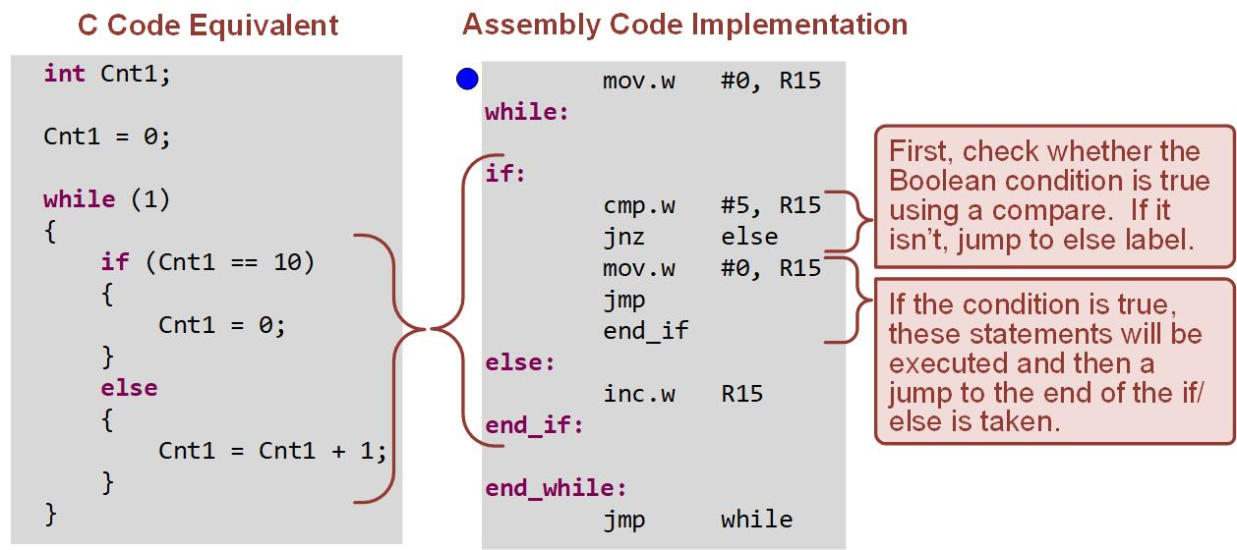
Ch. 8: Program Flow Instructions
Example: Implementing If/Else Statements in Assembly
8.3 Implementing Common Programming Constructs in Assembly

Slide 78
Ch. 8: Program Flow Instructions
Example: Implementing If/Else Statements in Assembly
Step 1: Create a new Empty Assembly-only project titled:
Asm_Flow_If_Else
Step 2: Type in the following code into the main.asm file where the comments say “Main loop here.”
Image Courtesy of https://neodem.wp.horizon.ac.uk/
Image Courtesy of https://neodem.wp.horizon.ac.uk/
8.3 Implementing Common Programming Constructs in Assembly

Slide 79
Ch. 8: Program Flow Instructions
Example: Implementing If/Else Statements in Assembly
Step 3: Debug your program and correct any errors.
Step 4: Set a breakpoint before the first instruction
mov.w #0, R15
Step 5: Open the register browser and observe R15.
Step 6: Run your program to the breakpoint.
Step 7: Step your program to observe the if/else construct’s behavior.
8.3 Implementing Common Programming Constructs in Assembly

Slide 80
Embedded Systems Design
Chapter 8: Program Flow Instructions
8.3 Implementing Common Programming Constructs in Assembly - if/else Statements
www.youtube.com/c/DigitalLogicProgramming_LaMeres
Brock J. LaMeres, Ph.D.

Slide 81
Embedded Systems Design
Chapter 8: Program Flow Instructions
8.3 Implementing Common Programming Constructs in Assembly - Switch/Case Statements
Brock J. LaMeres, Ph.D.

Slide 82
Ch. 8: Program Flow Instructions
8.3.4 Implementing Switch/Case Functionality
Switch/Case statement – allows a variable to be tested against a list of values.
This first value in the list that matches the variable will result int eh execution of statements associated with the value.
Similar to nested if/else statements, but the syntax is more amenable to large lists of comparisons.
This is implemented with a sequence of compare instructions, each with an associated conditional jump to a corresponding series of instructions to be executed.
Image Courtesy of https://neodem.wp.horizon.ac.uk/
Image Courtesy of https://neodem.wp.horizon.ac.uk/
8.3 Implementing Common Programming Constructs in Assembly

Slide 83
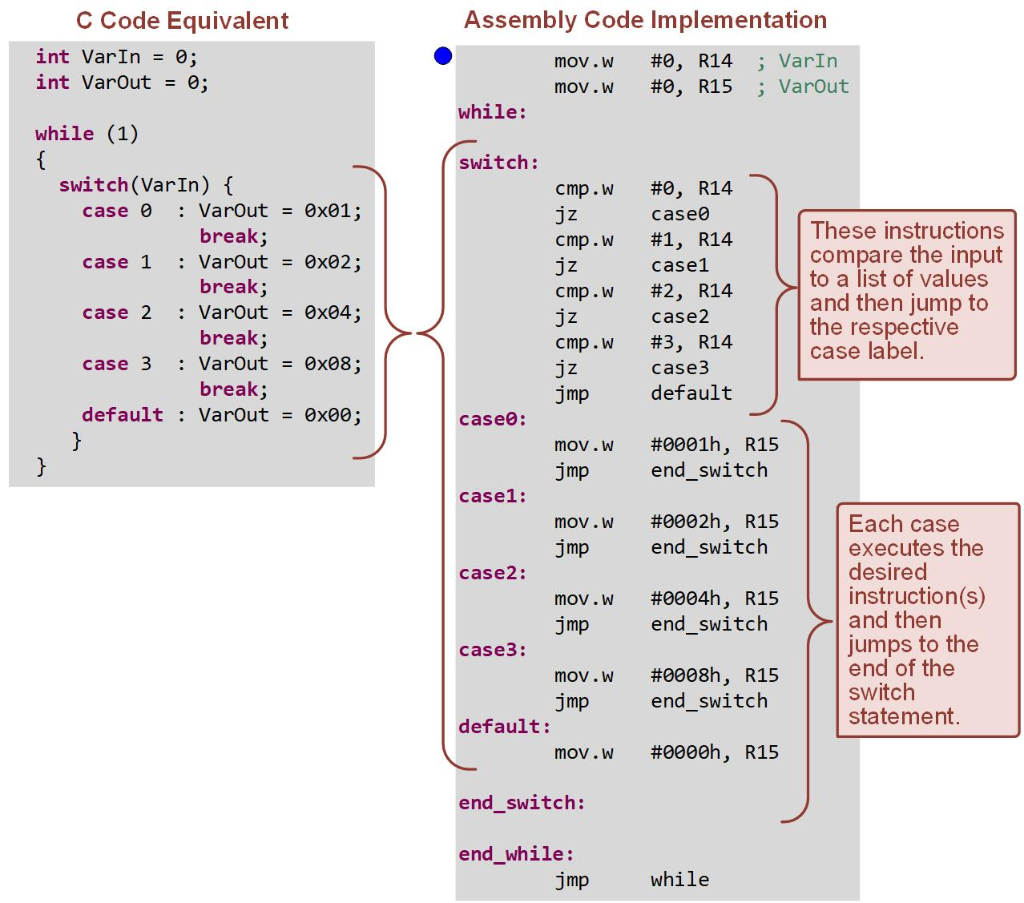
Ch. 8: Program Flow Instructions
Example: Implementing Switch/Case Statements in Assembly
8.3 Implementing Common Programming Constructs in Assembly

Slide 84
Ch. 8: Program Flow Instructions
Example: Implementing Switch/Case Statements in Assembly
Step 1: Create a new Empty Assembly-only project titled:
Asm_Flow_Switch_Case
Step 2: Type in the following code into the main.asm file where the comments say “Main loop here.”
Image Courtesy of https://neodem.wp.horizon.ac.uk/
Image Courtesy of https://neodem.wp.horizon.ac.uk/
8.3 Implementing Common Programming Constructs in Assembly

Slide 85
Ch. 8: Program Flow Instructions
Example: Implementing Switch/Case Statements in Assembly
Step 3: Debug your program and correct any errors.
Step 4: Set a breakpoint before the first instruction
mov.w #0, R14
Step 5: Open the register browser and observe R14 and R15.
Image Courtesy of
Recording Connection of Canada
Image Courtesy of
Recording Connection of Canada
Image Courtesy of
Recording Connection of Canada
Image Courtesy of
Recording Connection of Canada
Image Courtesy of
Recording Connection of Canada
Image Courtesy of
Recording Connection of Canada
Image Courtesy of
Recording Connection of Canada
Image Courtesy of
Recording Connection of Canada
Image Courtesy of
Recording Connection of Canada
Image Courtesy of
Recording Connection of Canada
Image Courtesy of
Recording Connection of Canada
Image Courtesy of
Recording Connection of Canada
Image Courtesy of
Recording Connection of Canada
Image Courtesy of
Recording Connection of Canada
Image Courtesy of
Recording Connection of Canada
Image Courtesy of
Recording Connection of Canada
Image Courtesy of
Recording Connection of Canada
Image Courtesy of
Recording Connection of Canada
Image Courtesy of
Recording Connection of Canada
Image Courtesy of
Recording Connection of Canada
Image Courtesy of https://neodem.wp.horizon.ac.uk/
Image Courtesy of https://neodem.wp.horizon.ac.uk/
8.3 Implementing Common Programming Constructs in Assembly

Slide 86
Ch. 8: Program Flow Instructions
Example: Implementing Switch/Case Statements in Assembly
Step 6: Run your program to the breakpoint.
Step 7: Step your program to observe the switch/case statemenet’s behavior.
Step 8: Manually alter the value of R14 by clicking in the register browser and entering values between 0 and 3. Remember to press enter and step again for these values to take place.
Image Courtesy of
Recording Connection of Canada
Image Courtesy of
Recording Connection of Canada
Image Courtesy of
Recording Connection of Canada
Image Courtesy of
Recording Connection of Canada
Image Courtesy of
Recording Connection of Canada
Image Courtesy of
Recording Connection of Canada
Image Courtesy of
Recording Connection of Canada
Image Courtesy of
Recording Connection of Canada
Image Courtesy of
Recording Connection of Canada
Image Courtesy of
Recording Connection of Canada
Image Courtesy of https://neodem.wp.horizon.ac.uk/
Image Courtesy of https://neodem.wp.horizon.ac.uk/
8.3 Implementing Common Programming Constructs in Assembly

Slide 87
Embedded Systems Design
Chapter 8: Program Flow Instructions
8.3 Implementing Common Programming Constructs in Assembly - Switch/Case Statements
www.youtube.com/c/DigitalLogicProgramming_LaMeres
Brock J. LaMeres, Ph.D.

Slide 88
Embedded Systems Design
Chapter 8: Program Flow Instructions
8.4 Flow Charts
Brock J. LaMeres, Ph.D.

Slide 89
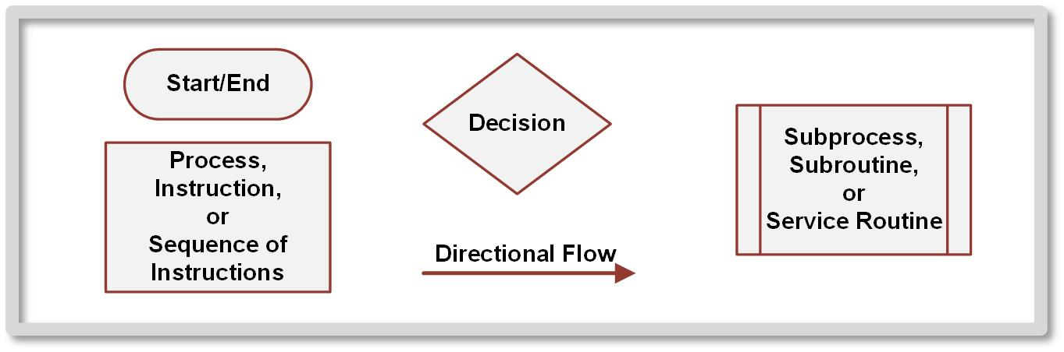
Ch. 8: Program Flow Instructions
8.4 Flow Charts
Flow chart – graphical depiction of the behavior of a program.
Flow charts allow the algorithm to be thought through prior to implementation.
Oval – represents the start and end to a program.
Rectangle – represents a process, which can be a single instruction or a sequence of instructions that accomplishes a specific task.
Image Courtesy of
Recording Connection of Canada
8.4 Flow Charts

Slide 90
Ch. 8: Program Flow Instructions
8.4 Flow Charts
Diamond – represents a decision where the corners of the shape represent different paths the program can take based on the decision.
Rectangle with double sides – represents a sequence of instructions that occurs separate from the main program flow; subroutine or service routine.
Image Courtesy of
Recording Connection of Canada
8.4 Flow Charts

Slide 91
Ch. 8: Program Flow Instructions
8.4 Flow Charts
Diamond – represents a decision where the corners of the shape represent different paths the program can take based on the decision.
Rectangle with double sides – represents a sequence of instructions that occurs separate from the main program flow; subroutine or service routine.
Image Courtesy of
Recording Connection of Canada
8.4 Flow Charts

Slide 92
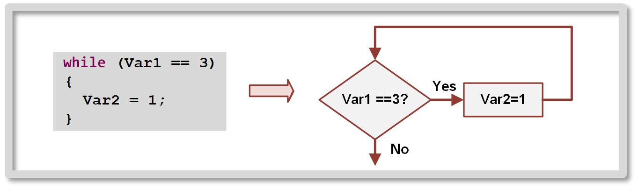
Ch. 8: Program Flow Instructions
8.4 Flow Charts – While() Loop
Image Courtesy of
Recording Connection of Canada
8.4 Flow Charts

Slide 93
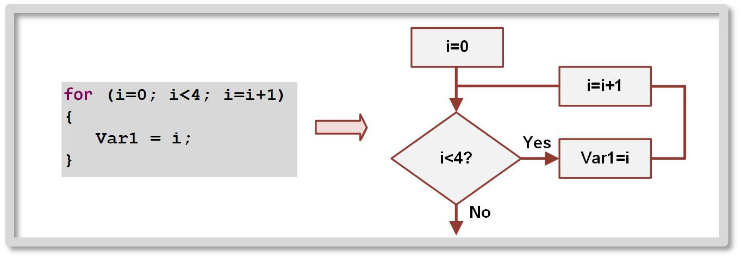
Ch. 8: Program Flow Instructions
8.4 Flow Charts – For() Loop
Image Courtesy of
Recording Connection of Canada
8.4 Flow Charts

Slide 94
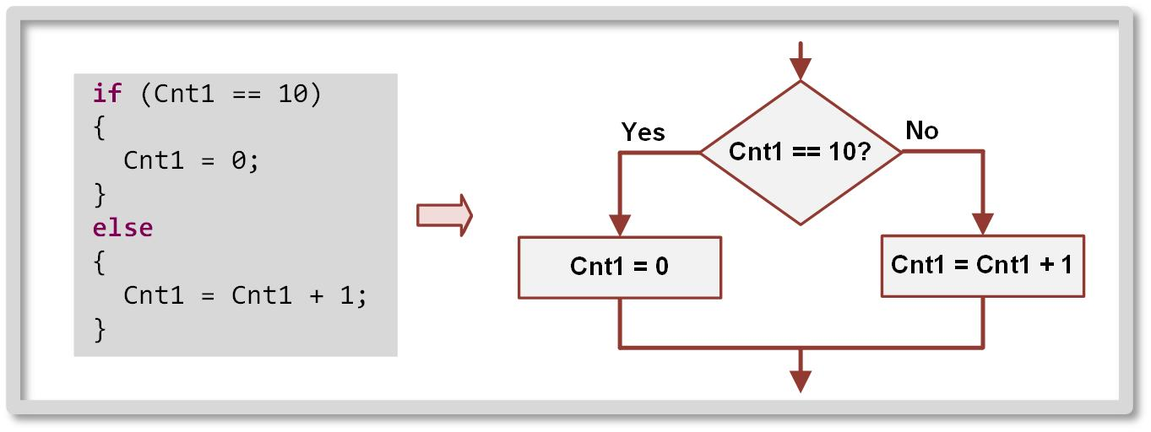
Ch. 8: Program Flow Instructions
8.4 Flow Charts – If/Else Statement
Image Courtesy of
Recording Connection of Canada
8.4 Flow Charts

Slide 95
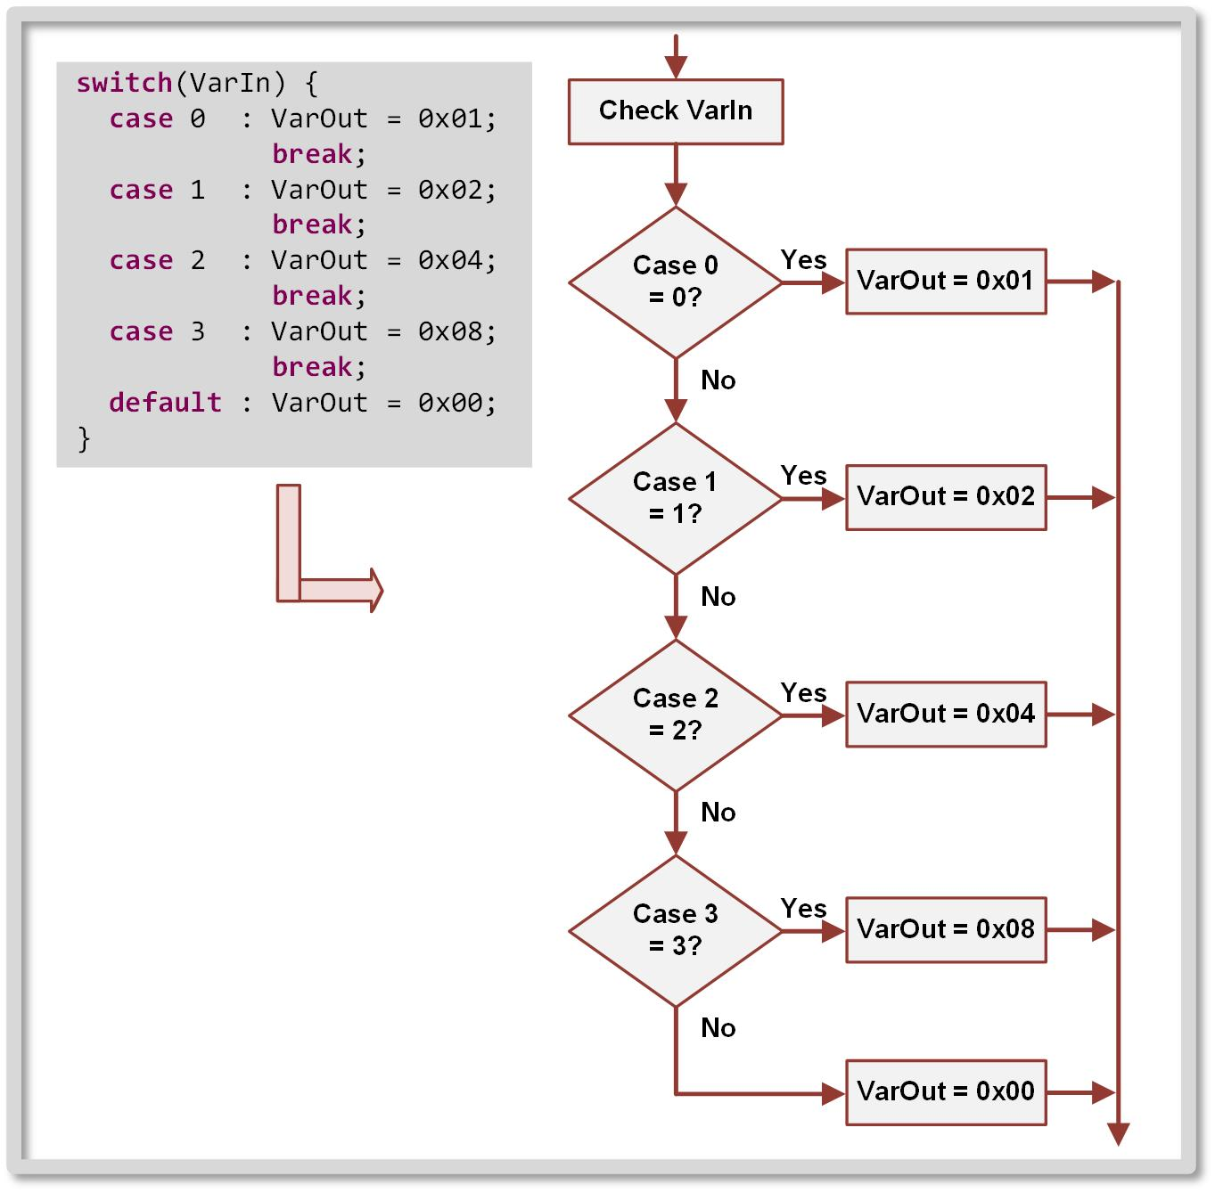
Ch. 8: Program Flow Instructions
8.4 Flow Charts – Switch/Case Statement
Image Courtesy of
Recording Connection of Canada
8.4 Flow Charts

Slide 96
Embedded Systems Design
Chapter 8: Program Flow Instructions
8.4 Flow Charts
www.youtube.com/c/DigitalLogicProgramming_LaMeres
Brock J. LaMeres, Ph.D.

Slide 97
Embedded Systems Design
Chapter 8: Program Flow Instructions
8.4 Flow Charts – Implementing Programs from Flow Charts
Brock J. LaMeres, Ph.D.

Slide 98
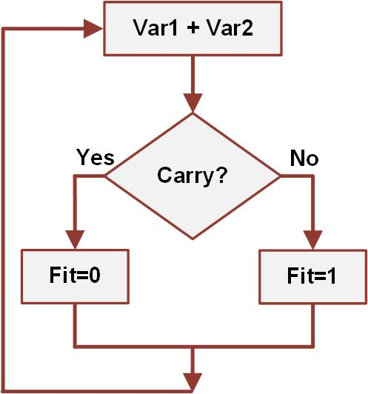
Ch. 8: Program Flow Instructions
Example: Implementing Assembly Code From a Flow Chart
Create an assembly program that will implement the functionality of the following flow chart. Var1, Var2, and Fit will be 16-bit variables in data memory that we need to reserve. Var1 and Var2 are updated by another process, but our program will need to update Fit per flow chart.
Step 1: Create a new Empty Assembly-only project titled:
Asm_Flow_DesignFromFlowChart
8.4 Flow Charts

Slide 99
Ch. 8: Program Flow Instructions
Example: Implementing Assembly Code From a Flow Chart
Step 2: Let’s think about the functionality of this flow chart.
First, we’ll need to reserve 3x words of data memory called Var1, Var2, and Fit.
Second, we’ll add Var1 and Var2 to the main program.
Third, we will need to check if the C-flag was asserted. We can use the jc and jnc conditional jumps for that.
Those jumps will go to labels that will set the value of Fit.
Finally, this loop needs to be repeated forever, which can be done by doing an unconditional jump to the start of the program (“main”).
8.4 Flow Charts

Slide 100
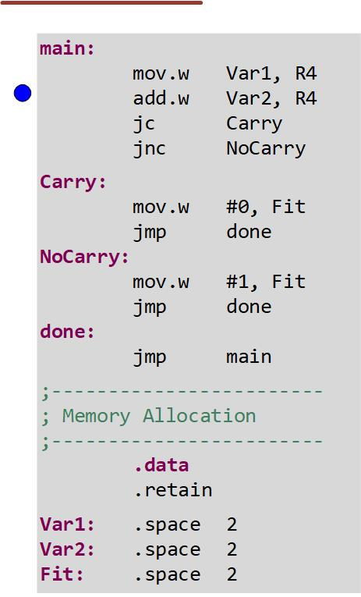
Ch. 8: Program Flow Instructions
Example: Implementing Assembly Code From a Flow Chart
Step 3: Type in the following code into the main.asm file where the comments say “Main loop here.”
8.4 Flow Charts

Slide 101
Ch. 8: Program Flow Instructions
Example: Implementing Assembly Code From a Flow Chart
Step 4: Debug your program and correct any errors.
Step 5: Set a breakpoint before the first instruction
Step 6: Open the memory browser and observe Var1, Var2, and Fit starting at address 0x2000h.
Step 7: Run your program to the breakpoint.
Step 8: Step your program to observe its behavior.
Image Courtesy of
Recording Connection of Canada
Image Courtesy of
Recording Connection of Canada
Image Courtesy of
Recording Connection of Canada
Image Courtesy of
Recording Connection of Canada
Image Courtesy of
Recording Connection of Canada
Image Courtesy of
Recording Connection of Canada
Image Courtesy of
Recording Connection of Canada
Image Courtesy of
Recording Connection of Canada
Image Courtesy of
Recording Connection of Canada
Image Courtesy of
Recording Connection of Canada
Image Courtesy of
Recording Connection of Canada
Image Courtesy of
Recording Connection of Canada
Image Courtesy of
Recording Connection of Canada
Image Courtesy of
Recording Connection of Canada
Image Courtesy of
Recording Connection of Canada
Image Courtesy of
Recording Connection of Canada
Image Courtesy of
Recording Connection of Canada
Image Courtesy of
Recording Connection of Canada
Image Courtesy of
Recording Connection of Canada
Image Courtesy of
Recording Connection of Canada
Image Courtesy of https://neodem.wp.horizon.ac.uk/
Image Courtesy of https://neodem.wp.horizon.ac.uk/
Image Courtesy of https://neodem.wp.horizon.ac.uk/
8.4 Flow Charts

Slide 102
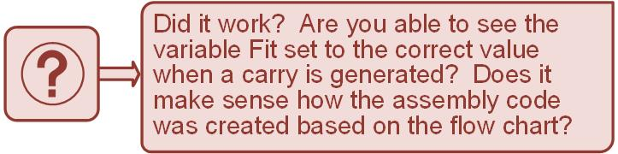
Ch. 8: Program Flow Instructions
Example: Implementing Assembly Code From a Flow Chart
Step 9: Manually change the values of Var1 and Var2 to generate a carry. Try setting Var1 = FFFFh and Var2 = 1 to generate a carry.
Image Courtesy of
Recording Connection of Canada
Image Courtesy of
Recording Connection of Canada
Image Courtesy of
Recording Connection of Canada
Image Courtesy of
Recording Connection of Canada
Image Courtesy of
Recording Connection of Canada
Image Courtesy of
Recording Connection of Canada
Image Courtesy of
Recording Connection of Canada
Image Courtesy of
Recording Connection of Canada
Image Courtesy of
Recording Connection of Canada
Image Courtesy of
Recording Connection of Canada
Image Courtesy of https://neodem.wp.horizon.ac.uk/
Image Courtesy of https://neodem.wp.horizon.ac.uk/
8.4 Flow Charts

Slide 103
Embedded Systems Design
Chapter 8: Program Flow Instructions
8.4 Flow Charts – Implementing Programs from Flow Charts
www.youtube.com/c/DigitalLogicProgramming_LaMeres
Brock J. LaMeres, Ph.D.

